Slide 1
Introduction to spring declarative transaction management
April 2019

Slide 2
agenda
Introduction to @Transactional
@Transactional attributes
Proxy-based transactions
Weaving-based transactions
Transactional events
Transactions isolation level

Slide 3
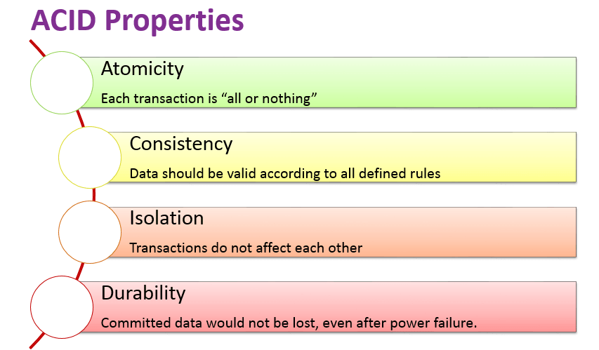
ACID recap

Slide 4

Why use transactions?

Slide 5
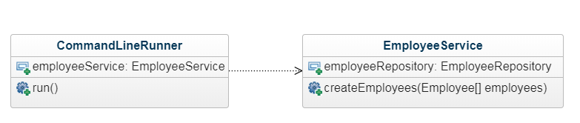
What we had

Slide 6
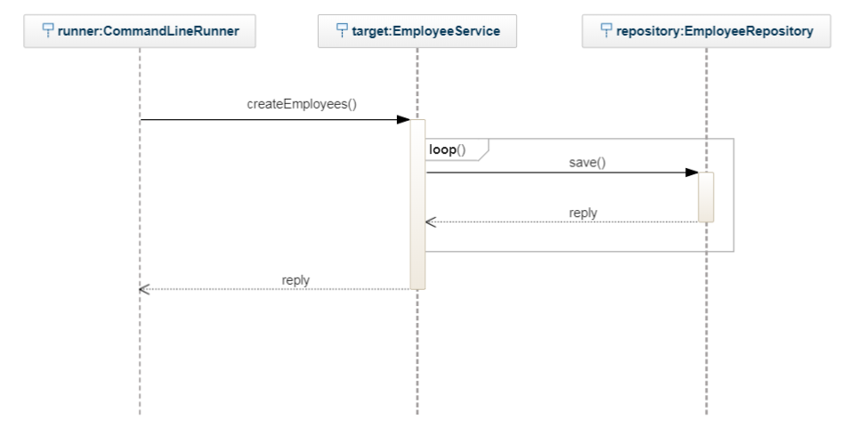
What we had

Slide 7
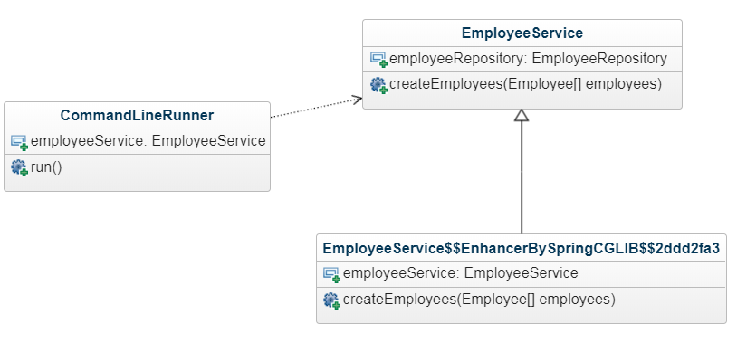
What we have now

Slide 8
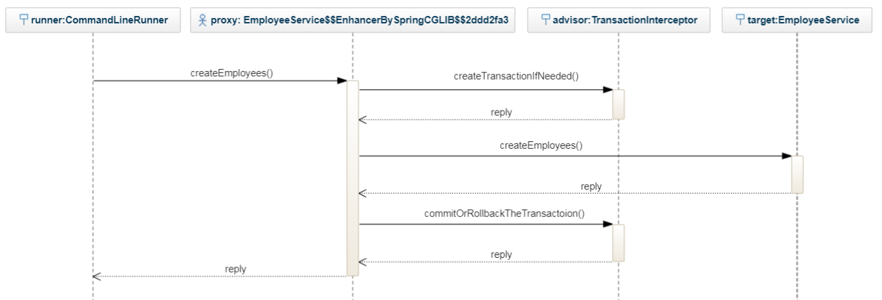
What we have now

Slide 9
@Transactional Attributes

Slide 10
@Transactional Attributes

Slide 11
@Transactional Attributes

Slide 12
@Transactional Attributes

Slide 13
@Transactional Attributes

Slide 14
@Transactional Attributes

Slide 15
@Transactional Attributes

Slide 16
@Transactional Attributes

Slide 17
@Transactional Attributes

Slide 18
@Transactional Attributes

Slide 19
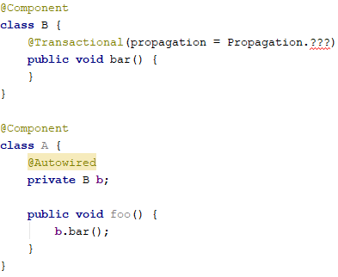
@Transactional propagation

Slide 20
@Transactional propagation
Propagation.REQUIRED
Existing Transaction
No Transaction
A
B
A
B
Caller Transaction
No Transaction
New Transaction

Slide 21
@Transactional propagation
Propagation.REQUIRES_NEW
Existing Transaction
No Transaction
A
B
A
B
Caller Transaction
No Transaction
New Transaction

Slide 22
@Transactional propagation
Propagation.SUPPORTS
Existing Transaction
No Transaction
A
B
A
B
Caller Transaction
No Transaction
New Transaction

Slide 23

@Transactional propagation
Propagation.MANDATORY
Existing Transaction
No Transaction
A
B
A
B
exception
Caller Transaction
No Transaction
New Transaction

Slide 24
@Transactional propagation
Propagation.NEVER
Existing Transaction
No Transaction
A
B
A
B
exception
Caller Transaction
No Transaction
New Transaction

Slide 25

@Transactional propagation
Propagation.NOT_SUPPORTED
Existing Transaction
No Transaction
A
B
A
B
Pause transaction
Caller Transaction
No Transaction
New Transaction

Slide 26
@Transactional propagation
Propagation.NESTED
Existing Transaction
No Transaction
A
B
A
B
JDBC Savepoint
Caller Transaction
No Transaction
New Transaction

Slide 27
Live coding: #1

Slide 28
Danger #1
When using proxy-based transactions, you can’t have non-public @Tranasctional methods

Slide 29
Live coding: #2

Slide 30
Danger #2
You can’t have @transactional @postconstruct methods

Slide 31
Live coding: #3

Slide 32
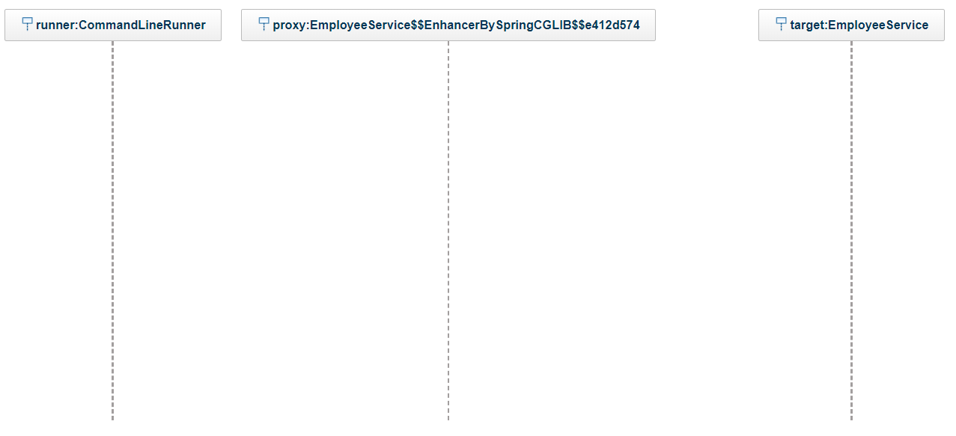
Proxy-based transactions flow

Slide 33
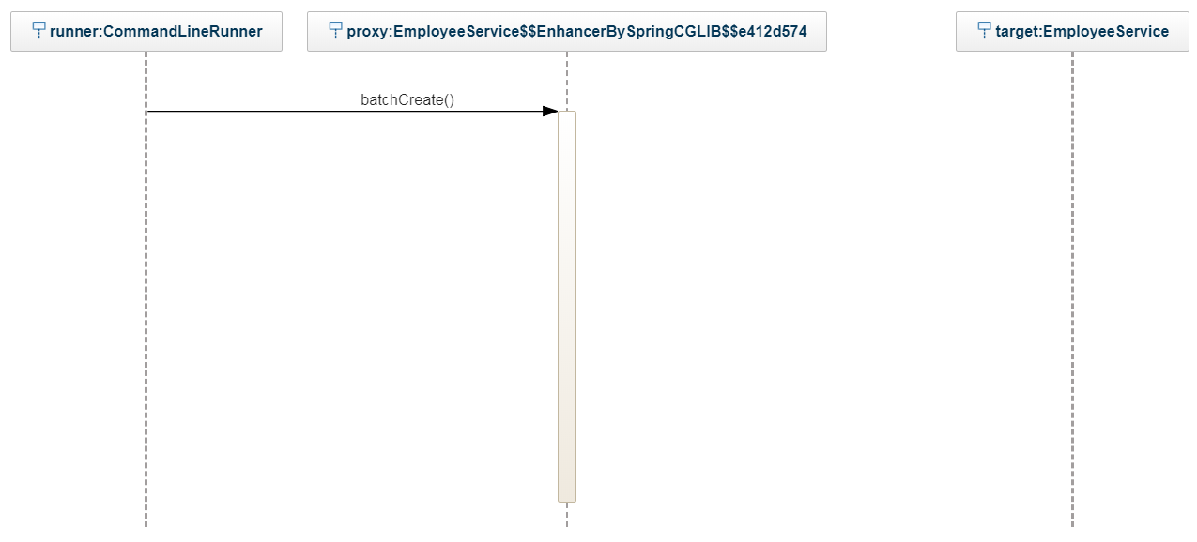
Proxy-based transactions flow

Slide 34
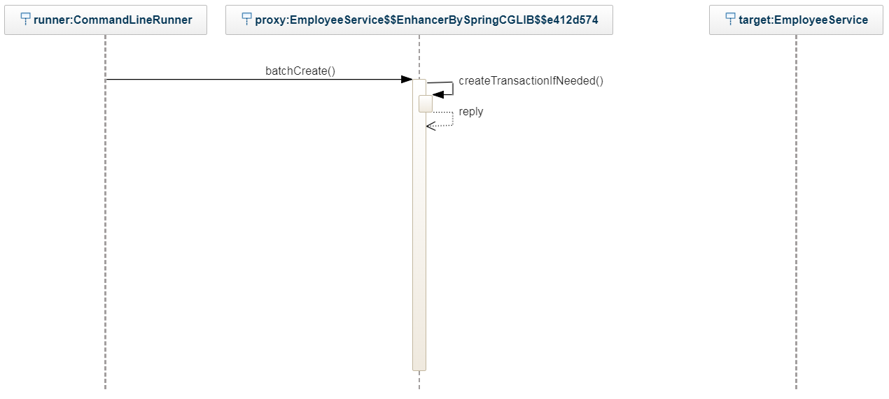
Proxy-based transactions flow

Slide 35
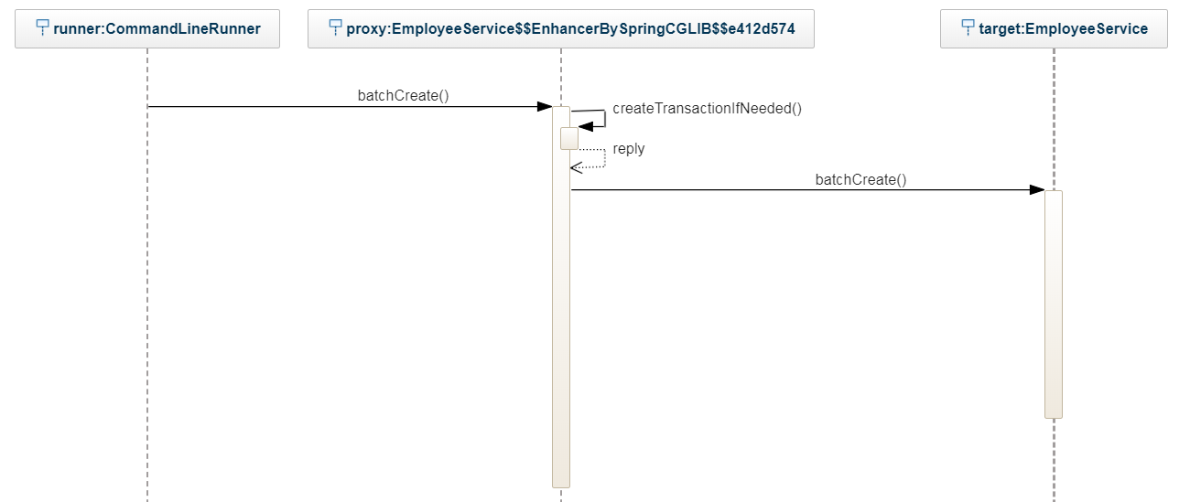
Proxy-based transactions flow

Slide 36
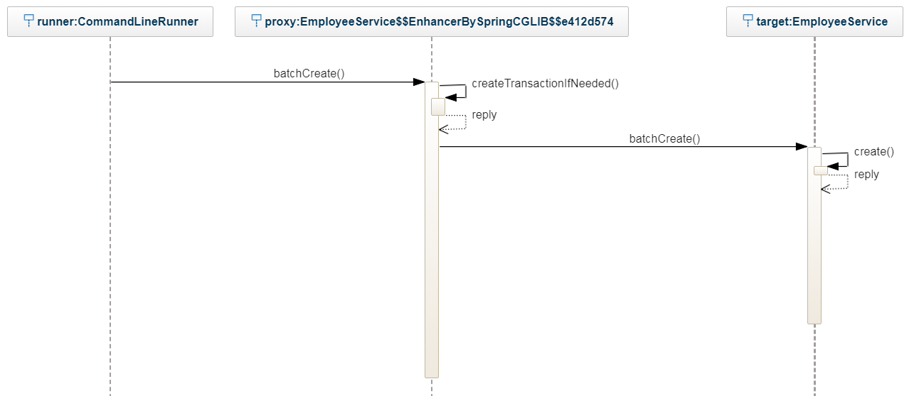
Proxy-based transactions flow

Slide 37
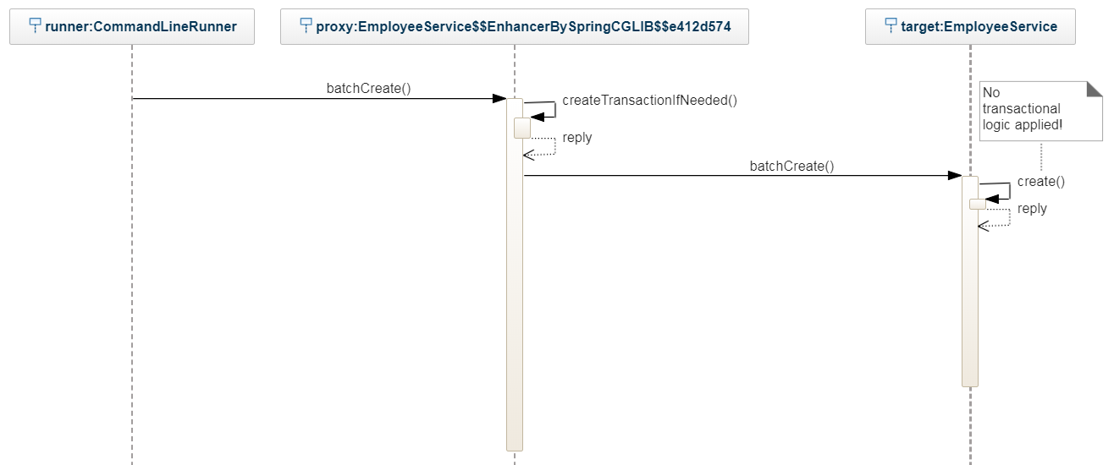
Proxy-based transactions flow

Slide 38
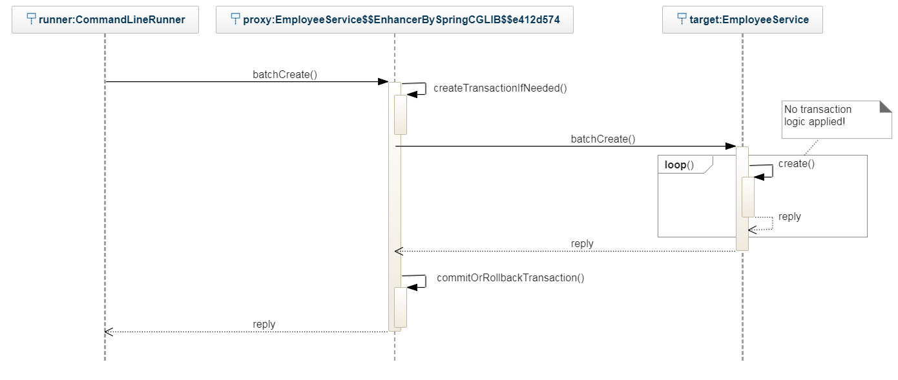
Proxy-based transactions flow

Slide 39
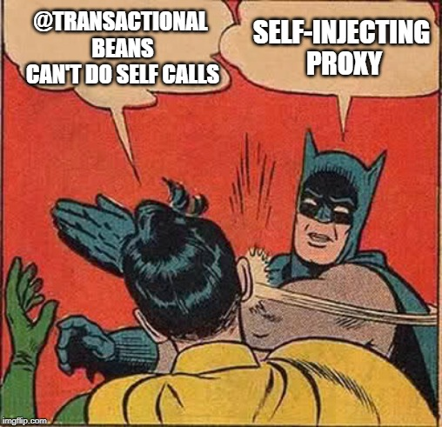

Slide 40
Live coding: #4

Slide 41

???

Slide 42
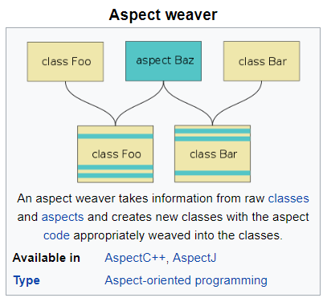
Introduction to Weaving
https://en.wikipedia.org/wiki/Aspect_weaver

Slide 43
Weaving types
Aspect weaver
Compile-time weaver
Post-compile time weaver
Load-time weaver

Slide 44
Live coding: #5

Slide 45
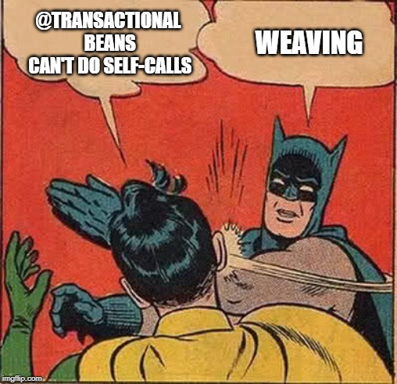

Slide 46
Live coding: #6

Slide 47
Transaction Isolation levels
SERIALIZABLE
REPEATABLE READ
READ COMMITTED
READ UNCOMMITTED

Slide 48
SERIALIZABLE
Transaction 1
Transaction 2

Slide 49
SERIALIZABLE
POOR PERFORMANCE

Slide 50
REPEATABLE_READ

Slide 51
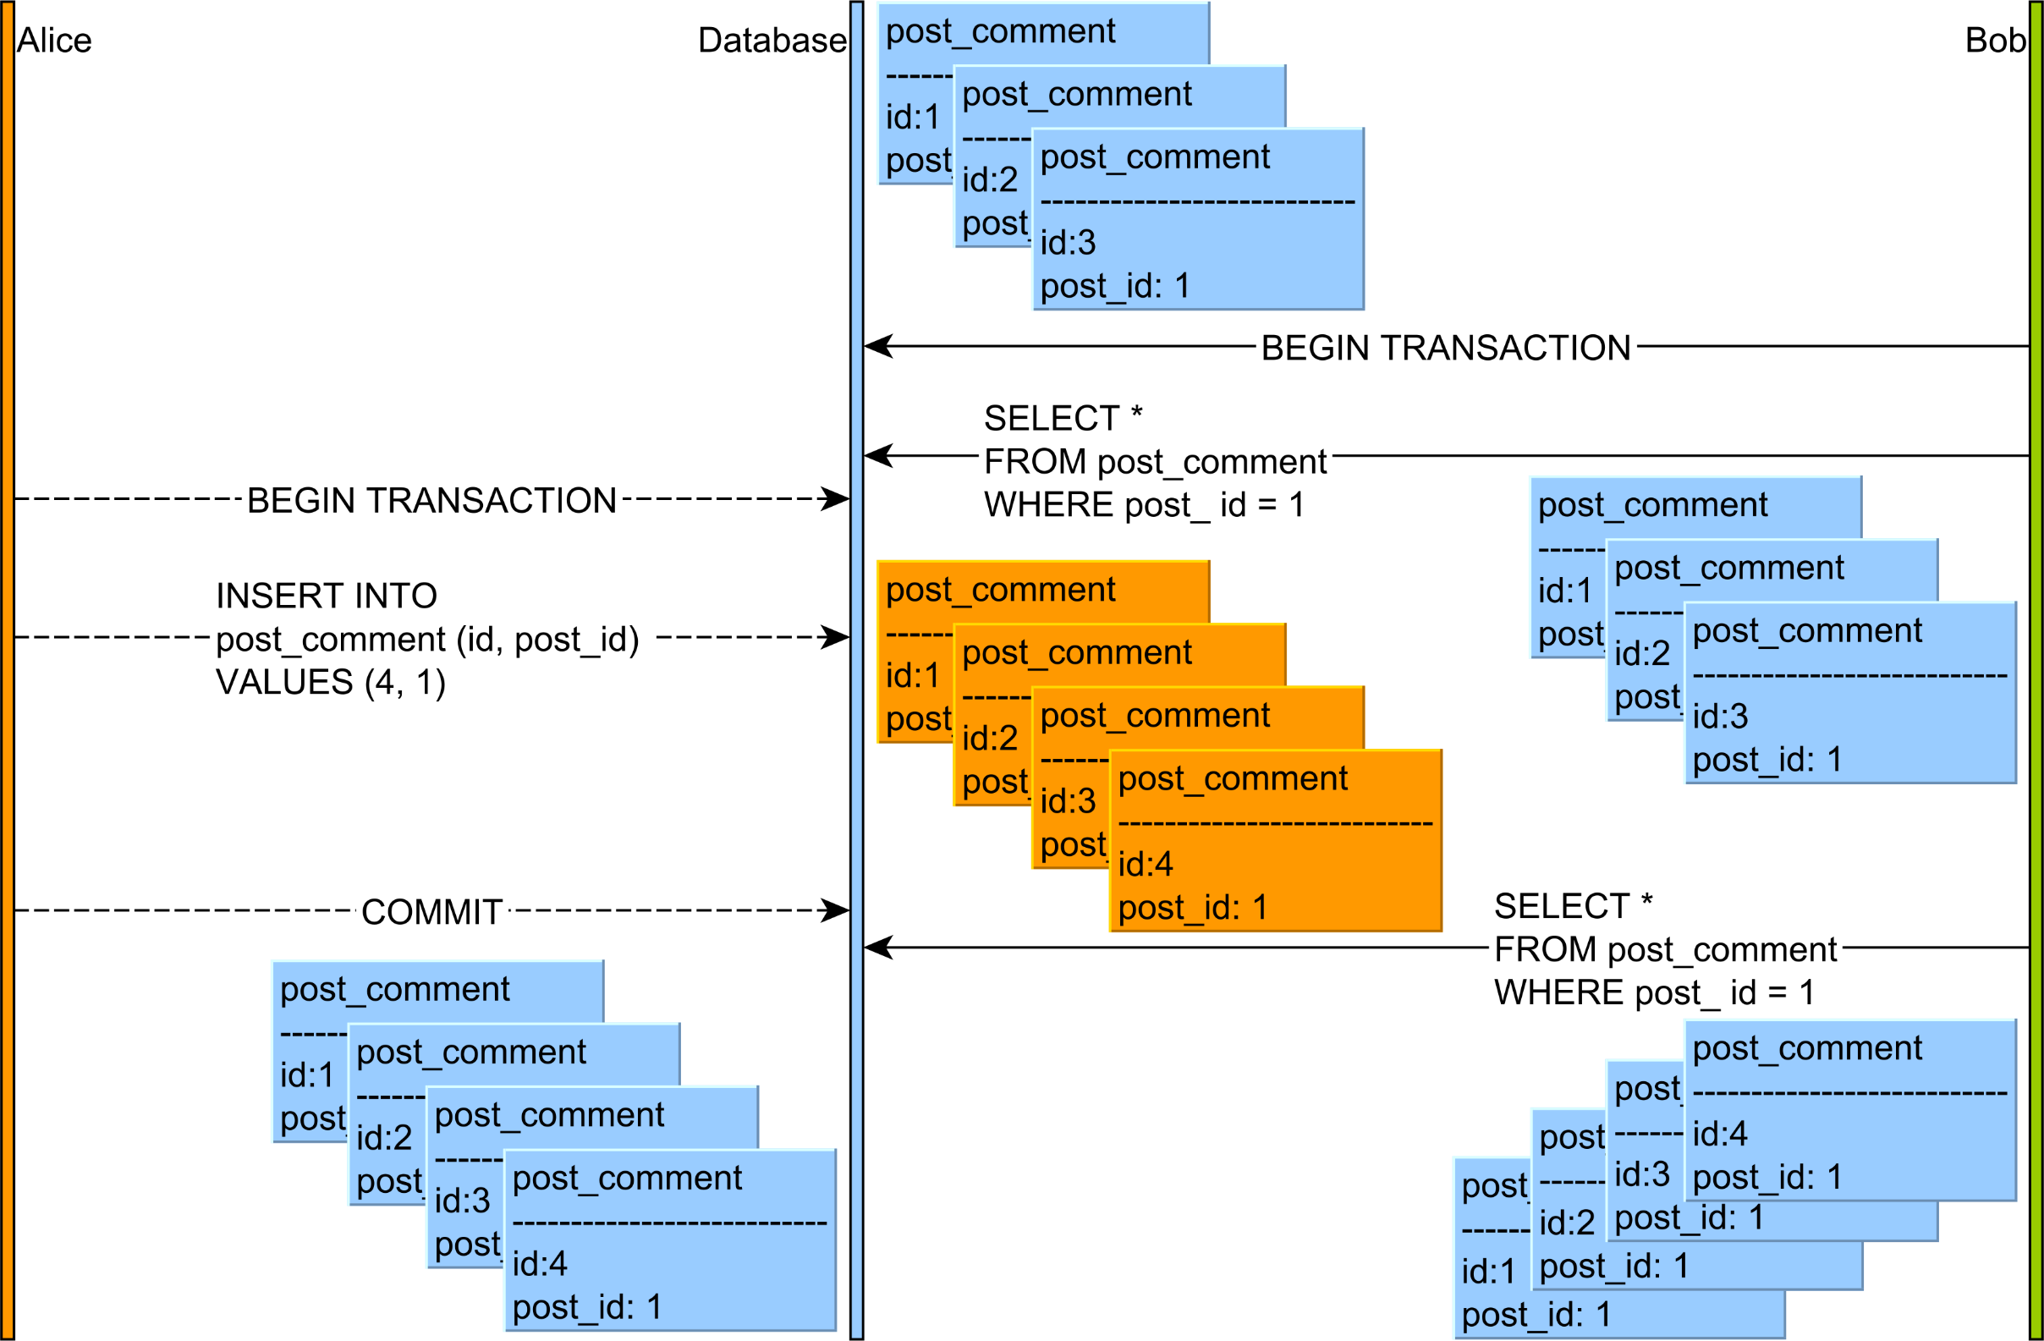
REPEATABLE_READ
https://vladmihalcea.com/phantom-read/

Slide 52
REPEATABLE_READ
Allows phantom reads

Slide 53
REPEATABLE_READ
Allows phantom reads
Performance better that serializable

Slide 54
READ_COMMITTED

Slide 55
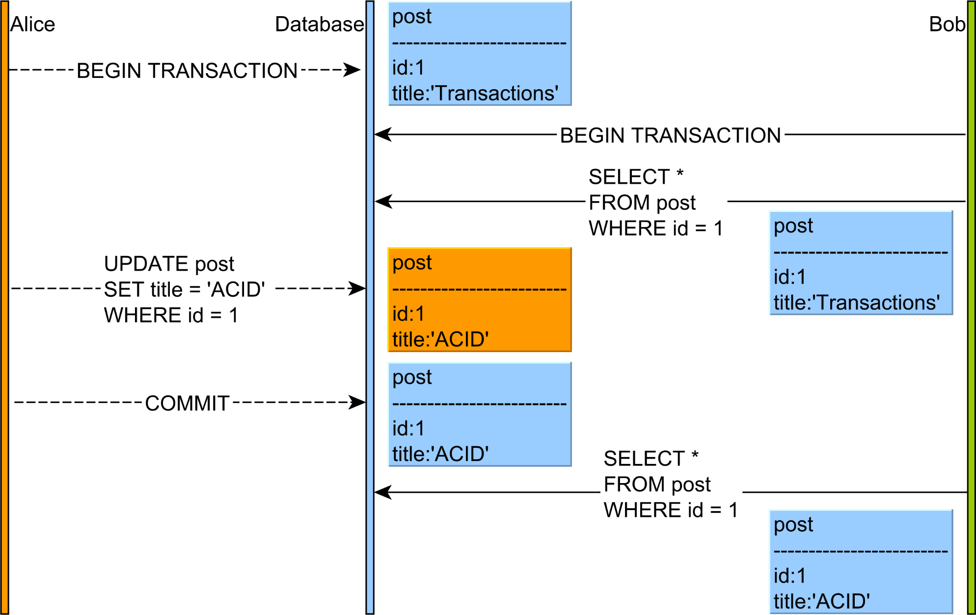
https://vladmihalcea.com/non-repeatable-read/

Slide 56
READ COMMITTED
Allows phantom reads
Allows non-repeatable reads

Slide 57
READ COMMITTED
Allows phantom reads
Allows non-repeatable reads
MOST POPULAR DEFAULT ISOLATION LEVEL

Slide 58
READ COMMITTED
Allows phantom reads
Allows non-repeatable reads
MOST POPULAR DEFAULT ISOLATION LEVEL
Performance better than repeatable_read

Slide 59
READ_UNCOMMITTED

Slide 60
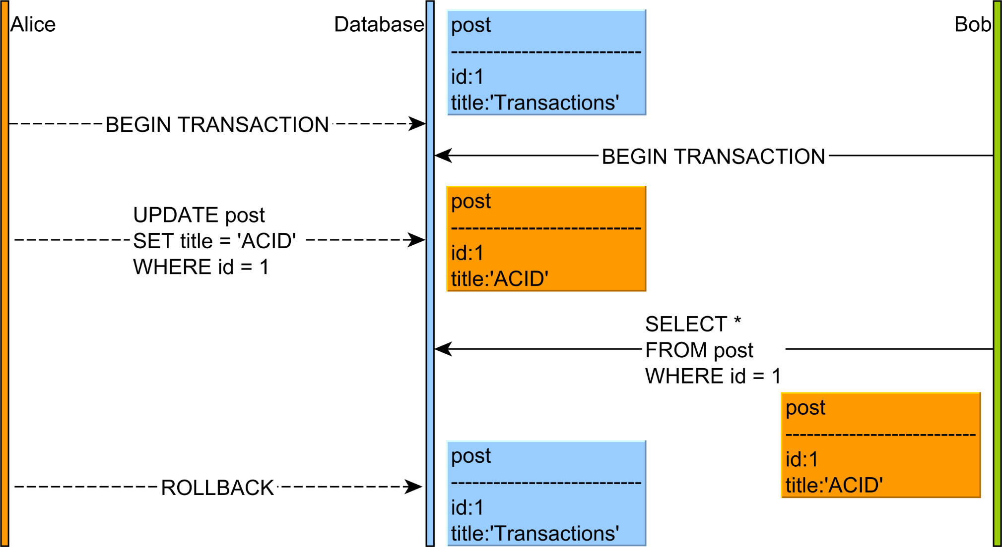
https://vladmihalcea.com/dirty-read/

Slide 61
READ unCOMMITTED
Allows phantom reads
Allows non-repeatable reads
Allows DIRTY reads

Slide 62
READ unCOMMITTED
Allows phantom reads
Allows non-repeatable reads
Allows DIRTY reads
FASTEST ISOLATION LEVEL

Slide 63
Lost updates

Slide 64
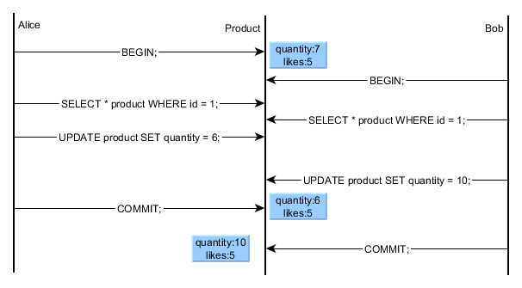
https://vladmihalcea.com/a-beginners-guide-to-database-locking-and-the-lost-update-phenomena/

Slide 65
ISOLATION Recap
Because the most common default isolation level is read_committed
You have to think about how you would solve:
Phantom reads
Non-repeatable reads
Lost updates

Slide 66
ISOLATION Recap
¯\_(ツ)_/¯

Slide 67
THANK YOU
Andrei Roșca
Java developer
+373 69952044
Andrei.Rosca@endava.com

